Slide 1

HKBK COLLEGE of ENGINEERING Department of Computer Science and Engineering
HUMAN RESOURCE MANAGEMENT
SYSTEM
By
Aastha Gupta-1HK16CS003
Fathima Zohra-1HK16cs047
Under the Guidance of
Mrs.Amreen Khanam
Notes:
‹#›

Slide 2
Agenda / Outline
Introduction
System architecture
ER Diagram
Schema diagram
Implementation(Front end, Back end)
*
Department of CSE,HKBKCE

Slide 3
Introduction
It provides the complete information of employees of the organization.
The main objective of the system is to maintain and retrieve information about the
entire personnel framework of the organizational system.
It is a easy management of databases of various sections
covering key aspects.
By entering the details of each employee, we can get all types of reports instantly, which will be useful to call back the information of each employee and performance of each employee.
We can search for all employees,departments, dependent information etc. is possible which can be department wise, level-wise and other parameter based search enabled.
.
Department of CSE,HKBKCE

Slide 4
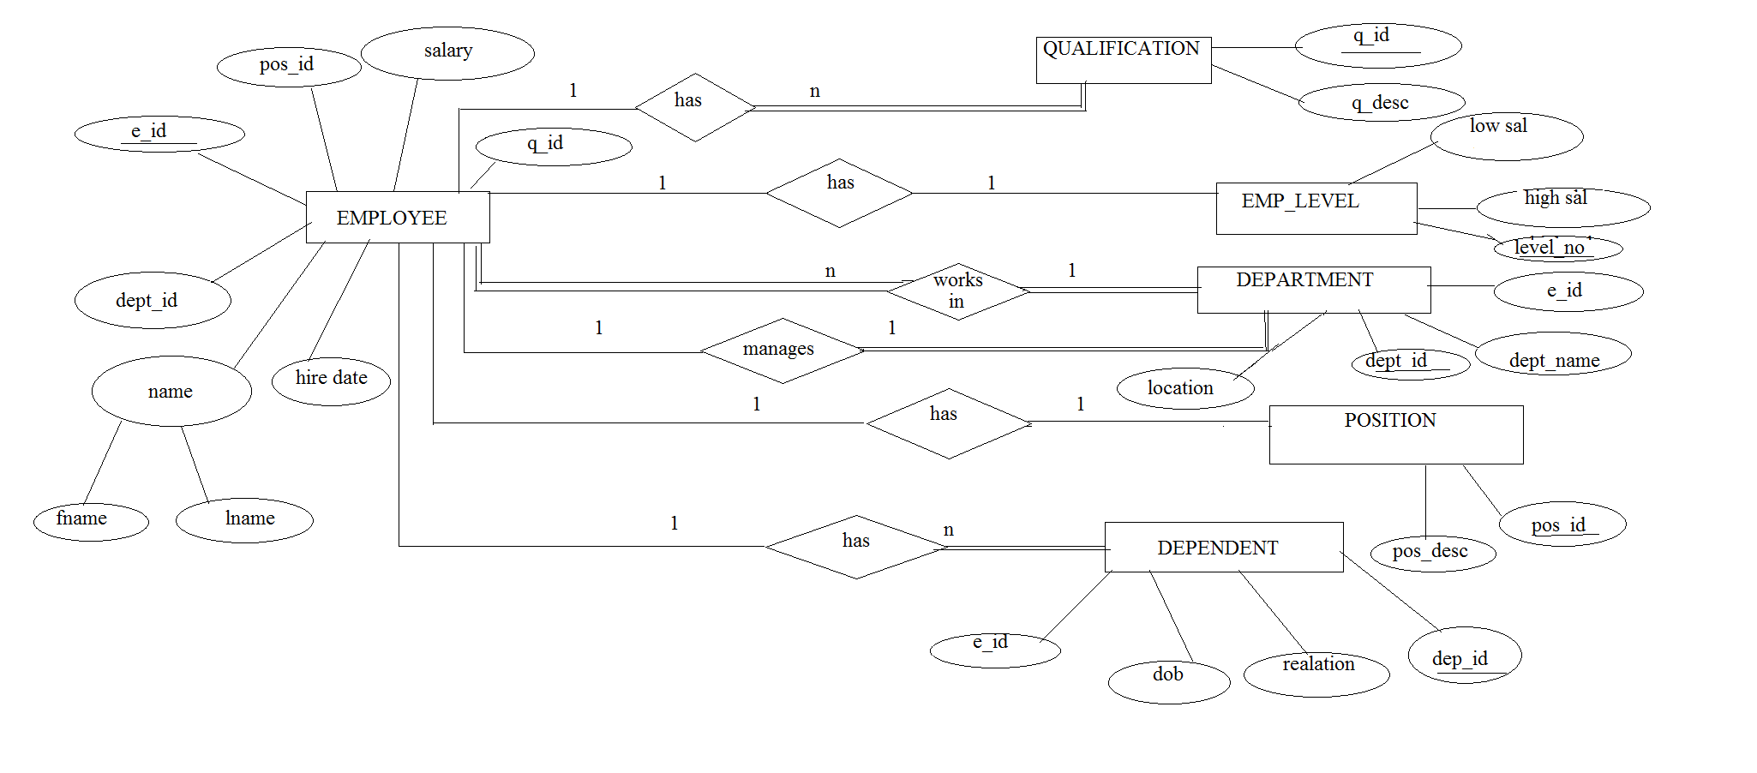
ER Diagram
*
Department of CSE,HKBKCE

Slide 5
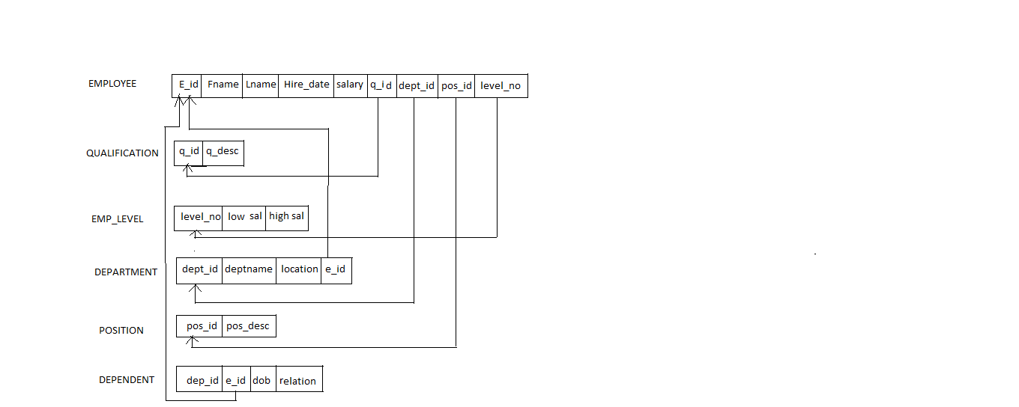
Schema Diagram
*
Department of CSE,HKBKCE

Slide 6
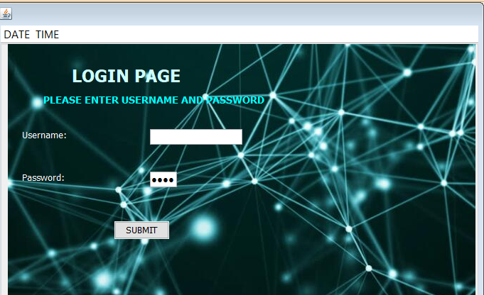
Implementation
login page:
*
Department of CSE,HKBKCE

Slide 7
IMPLEMENTATION
CODE FOR ACCESS LOGIN
Try{
Connection con=DriverManager.getConnection(‘jdbc:mysql://localhost/employee”,”root”,” ”);
String query =”{CALL ADMINLOGIN(? ? ?)”:
CallableStatement cs=con.preparedCall(query);
cs.setString(1,Username);
cs.setString(1,password);
cs.registerOutParameter(3,Types.INTEGER);
cs.execute( );
int count =cs.getInt(3);
if(count==1){
JOptionPane.showMessageDialog(null,”login successful!!!”+”\n”+”welcome admin”);
*
Department of CSE,HKBKCE

Slide 8
IMPLEMENTATION
menuif nm=new menuif( );
this.getParent().add(nm);
nm.setVisible(true);
this.setVisible(false);
}
else{
JoptionPane.showmessageDialog(null,”unsuccessful”);
}
}
catch(SQLException ex)
{
Logger.getLogger(login.class.getName()).log(Level.SEVERE,null,ex);
} }
*
Department of CSE,HKBKCE

Slide 9
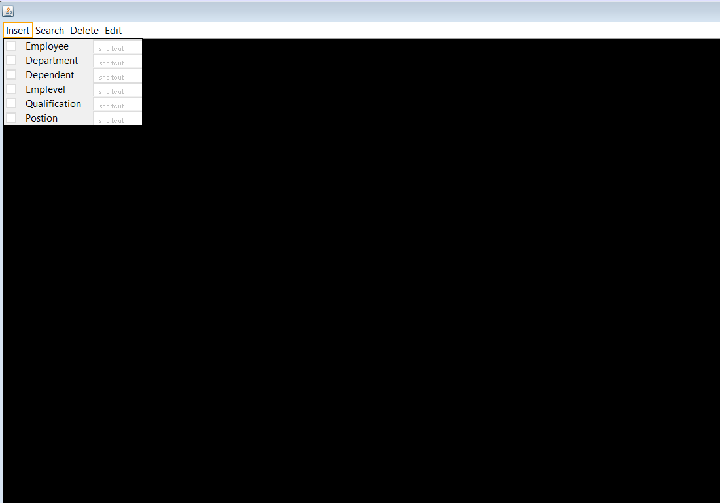
*
Department of CSE,HKBKCE

Slide 10
try{
String url="jdbc:derby://localhost:1527/addemployee";
String username="abc";
String password="1234";
Connection conn=DriverManager.getConnection(url,username,password);
Statement stmt=conn.createStatement();
stmt.execute (“insert into addemployee(NAME, BIRTHDAY, BIRTH MONTH,BIRTH YEAR, ID, ADDRESS ,SEX,
SALARY , DEPARTMENT ID,POSITION ID, QUALIFICATION ID, MOBILE, HIREDAY, HIRE MONTH, HIRE
YEAR ) VALUES (“+"+NameText.getText()+"','"+ BirthDay.getSelectedItem()+"','"+ Birth Month.getSelectedItem()+"','"+
Birth Year.getSelectedItem()+"','"+id.getText()+"','"+address.getText()+"','"+"sex.getSelectedItem(+ salary.getText()+"','
'+ department.getSelectedItem()+"','"+ pos.getSelectedItem()+"','"+qualification.getSelectedItem()+"','"+mobile.getText()+"','"+ HireDay.getSelectedItem()+"'
HireMonth.getSelectedItem()+"','"+ HireYear.getSelectedItem()+"')");
*
Department of CSE,HKBKCE

Slide 11
JOptionPane.showMessageDialog(null,"Employee added to database");
NameText.setText(null);
BirthDay.setSelectedItem(00);
Birth Month .setSelectedItem(00);
BirthYear.setSelectedItem(00);
id.setText(null);
address.setText(null);
sex.setSelectedItem(00);
salary.setText(null);
department.setSelectedItem(0);
pos.setSelectedItem(0);
qualification.setSelectedItem(0);
mobile.setText(null);
HireDay.setSelectedItem(00);
HireMonth.setSelectedItem(00);
HireYear.setSelectedItem(00); }
*
Department of CSE,HKBKCE

Slide 12
THANK YOU !!!
*
Department of CSE,HKBKCE

